Slide 1
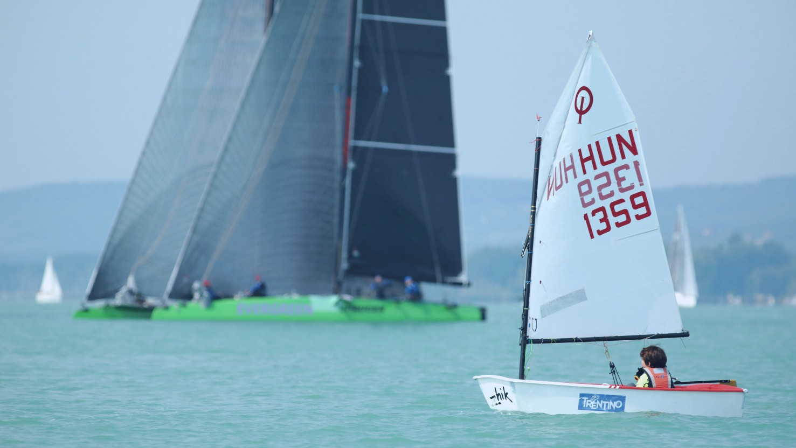

APPLICATION
HUNGAR I AN YACHT I NG ASSOCI AT I ON
TRAINING AND DEVELOPMENT SIMPOSYUM
2019
Prepared by:
András Holczhauser
Secretary General

Slide 2
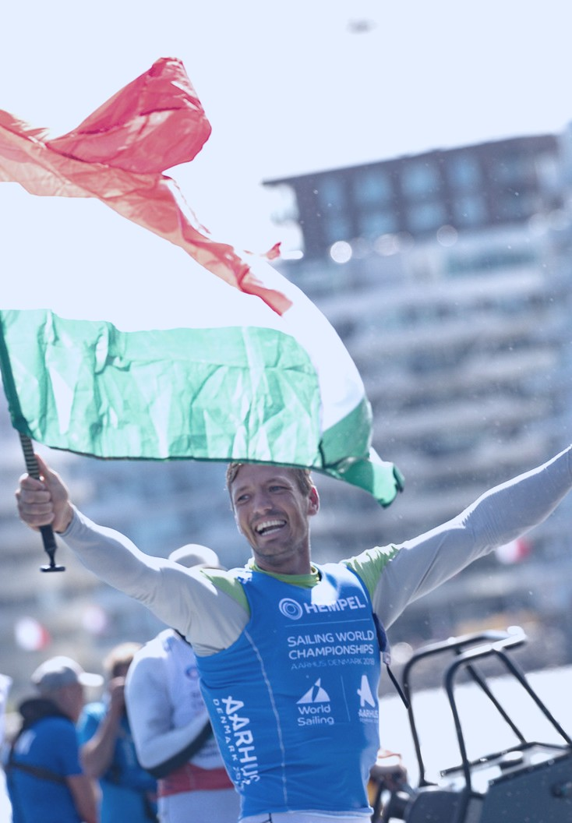
CONTENT
Our Topics
The Venue
Lake Balaton Balatonfüred
Anna Grand Hotel
Marinas & Boats
The Applicant
About HYA
International Events
Youth sailing
HYA & WS
HUNGARIAN YACHTING ASSOCIATION| HUNSAIL. HU

Slide 3
THE VENUE

Slide 4
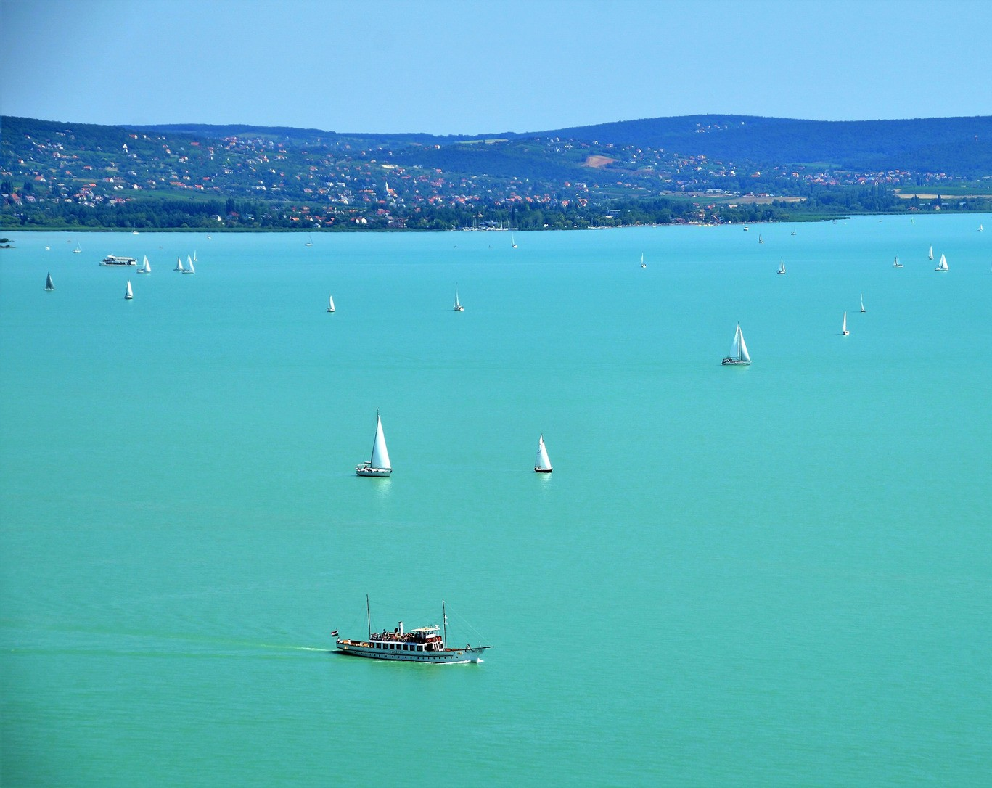
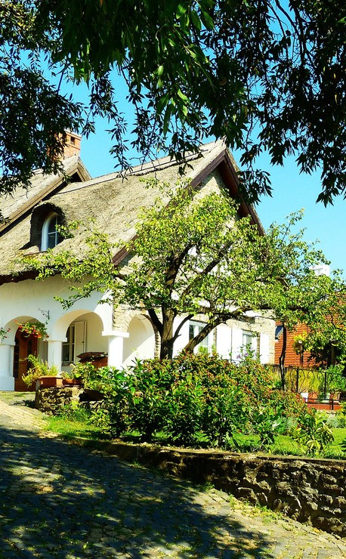
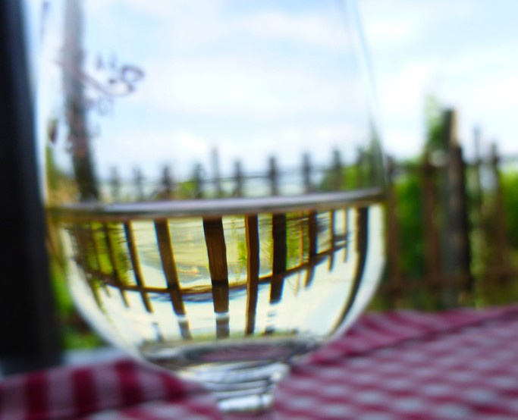
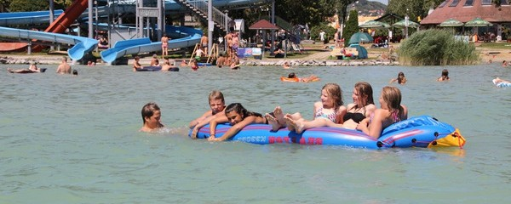
BALATON
THE LARGEST LAKE IN CENTRAL EUROPE
Lake Balaton is a freshwater lake in the Transdanubian region of Hungary. It is the largest lake in Central Europe, and one of the region's foremost tourist destinations.
The "Hungarian Sea", is the people's name for the 50-mile long lake with silky green-yellow water. Lake Balaton is one of Hungary's most precious treasures and most frequented resorts.
The southern shores are ideal for small children because of the shallow water, but on the north shore the water gets deeper instantaneously. The summer water temperature is around 80 °F, which is warmer than the average air temperature in the morning and in the evening.
Picturesque vineyards in the region produce an assortment of excellent wines that go very well with the delicious local food. Large numbers of inns and restaurants welcome guests from home and abroad.
HUNGARIAN YACHTING ASSOCIATION | HUNSAIL. HU

Slide 5
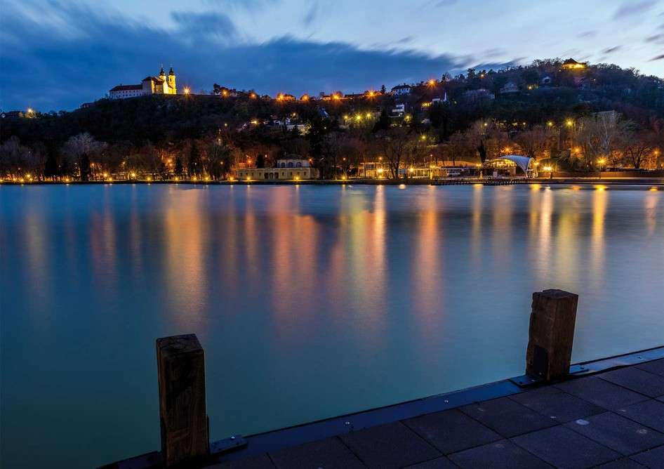
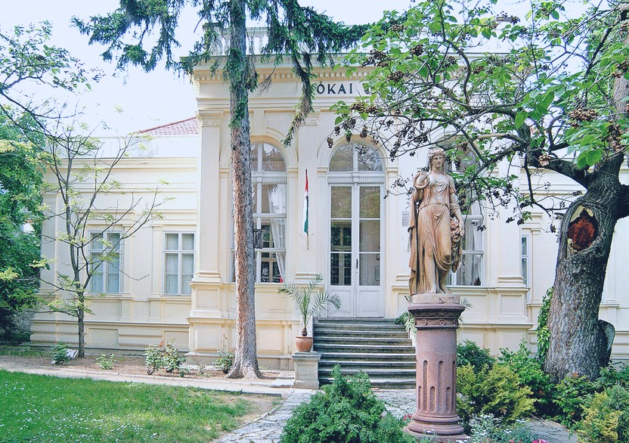
BALATONFÜRED
The "Hungarian Riviera"
Balatonfüred is located on the northern shore of the lake, and the third largest city on Lake Balaton. The town has a history reaching back to 800 years. Balatonfüred and its surrounding settlements lie in the so-called "Hungarian Riviera”.
The town was inhabited already when the Romans conquered parts of Hungary. Walking in the town the visitor every now and then faces relics of old times. Ancient living quarters, old buildings, churches, homely vineyards, parks, mighty old trees preserve and whisper their messages to the people living here today.
Travellers start to feel the harmonious blend of past and present at the moment of their arrival. First and foremost the location of the town captures everyone: tender mountains on the north, the beautiful lake on the south embrace the town, which radiates that special Transdanubian serenity for ages.
The town’s main attractive forces lie in its beautiful natural location, the healing effect of its acidulous springs, and in those delicious, good quality wines that grow here on the hills close to the Lake.
HUNGARIAN YACHTING ASSOCIATION| HUNSAIL. HU

Slide 6
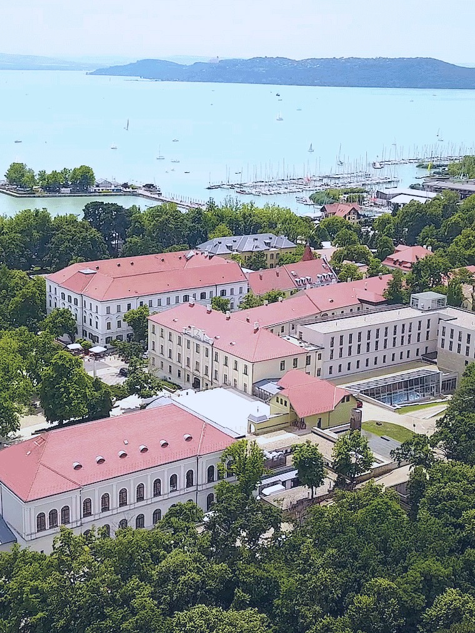
ANNA GRAND HOTEL
**** Wine & Vital
The four-star Anna Grand Hotel building complex is located a 100 meters away from the famous Tagore Promenade and Lake Balaton, in the middle of the historical district of Balatonfüred.
Dates & prices:
March 18-21 2019 March 21-24, 2019
(Monday to Thursday) (Thursday to Sunday)
Double occupancy: 88 EUR / room / night 102 EUR / room / night
Single occupancy: 70 EUR / room / night 82 EUR / room / night
Services:
Free airport transfer, breakfast, indoor swimming pool, indoor jacuzzi, sauna park
Social events - 2 sponsored dinner:
- meeting with the mayor of Balatonfüred
- meeting with the president of Hungarian Yacting Association
HUNGARIAN YACHTING ASSOCIATION | HUNSAIL. HU

Slide 7
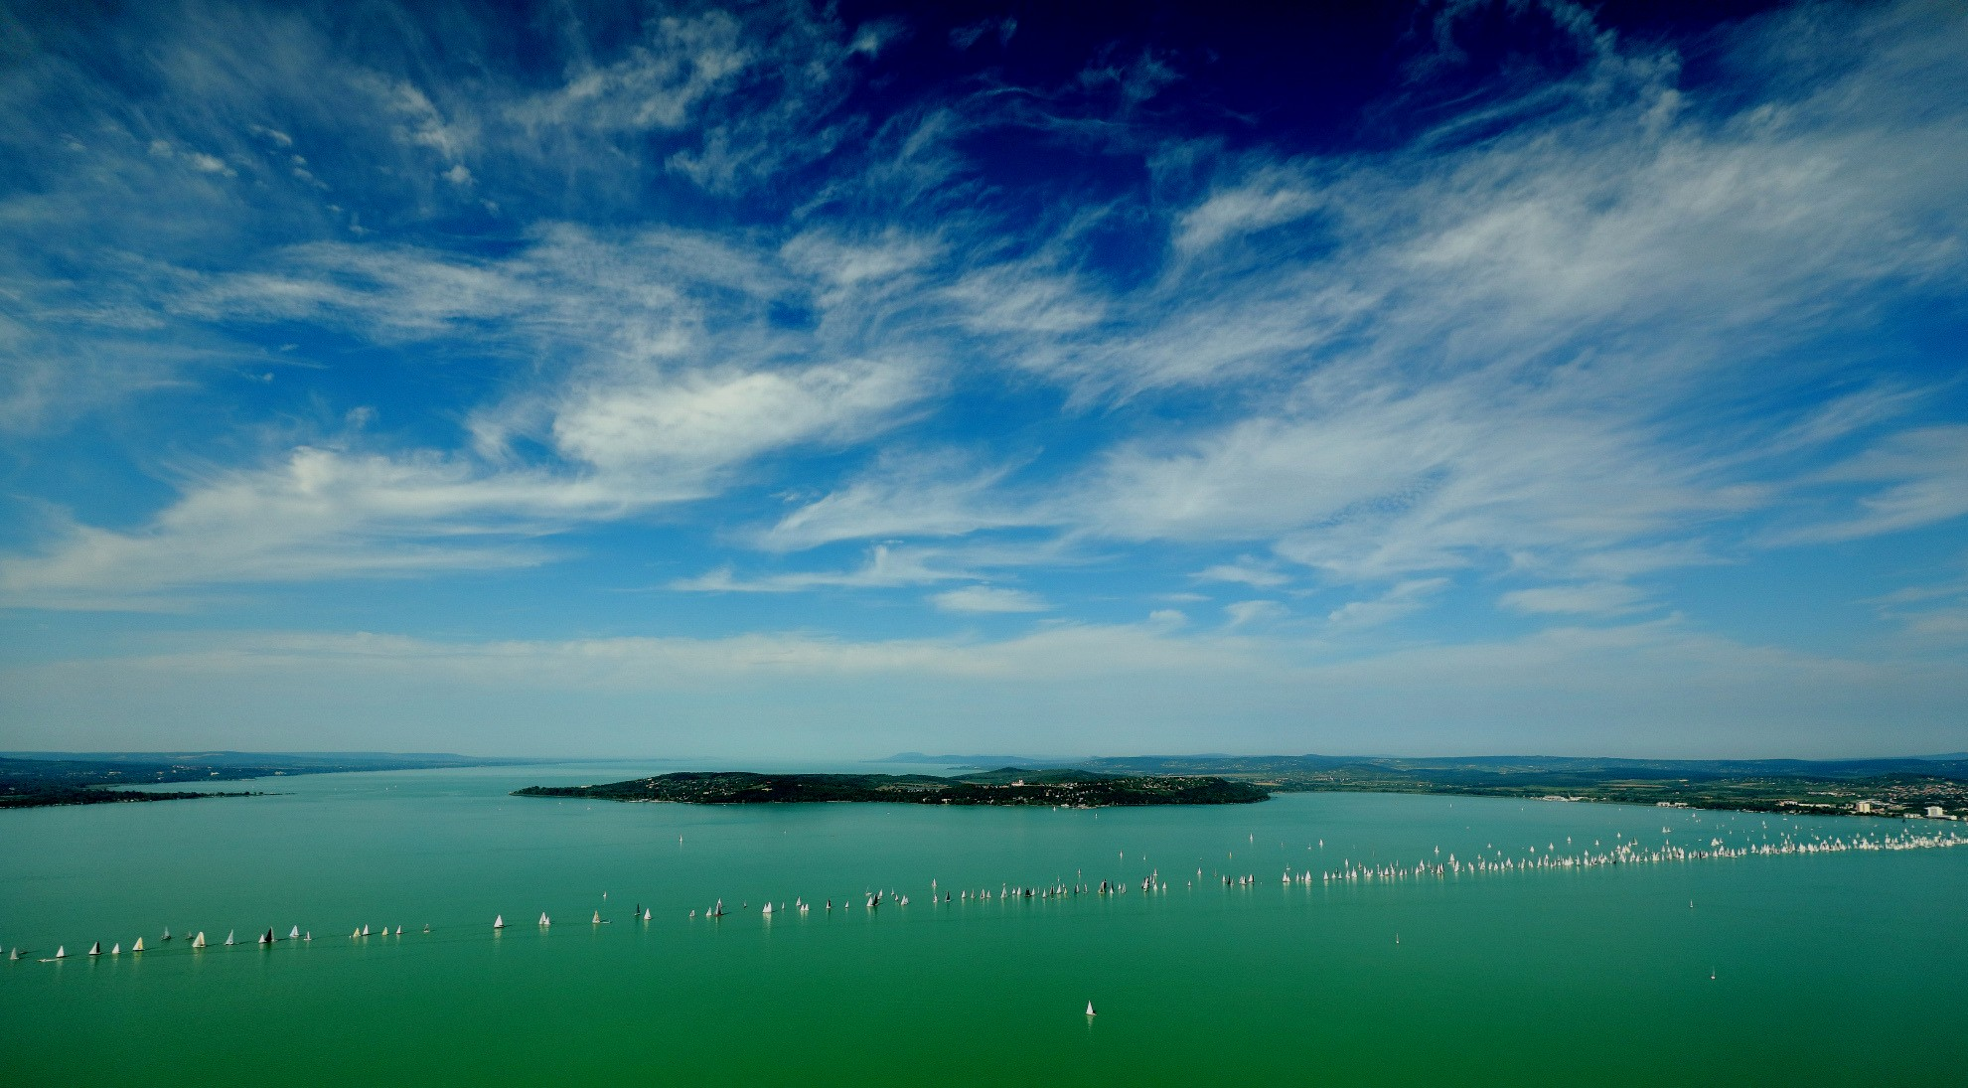
1500
SAILING BOATS
11
MARINAS
BUBBLY SAILING LIFE
B A L A T O N F Ü R E D I S T H E C A P I T A L O F H U N G A R I A N S A I L I N G

Slide 8
ABOUT THE APPLICANT

Slide 9
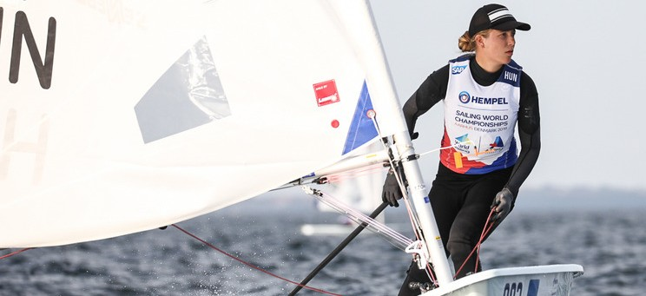
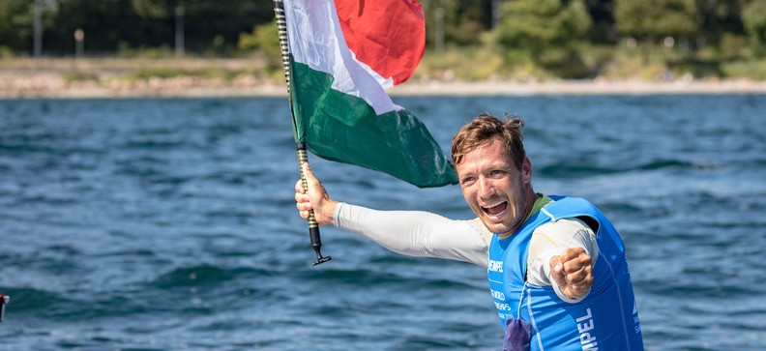

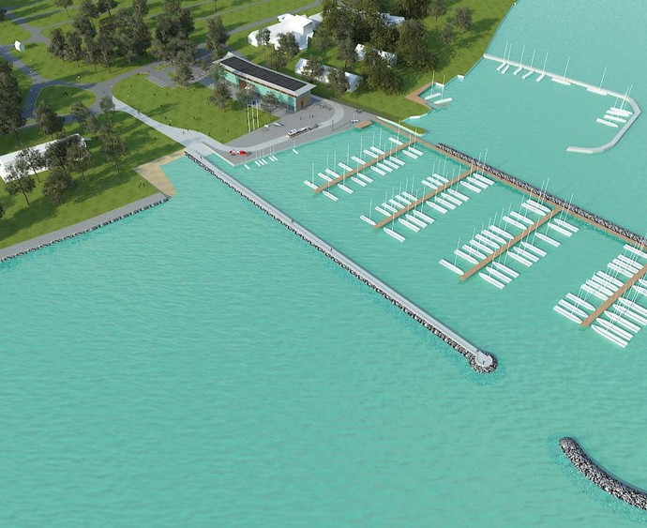
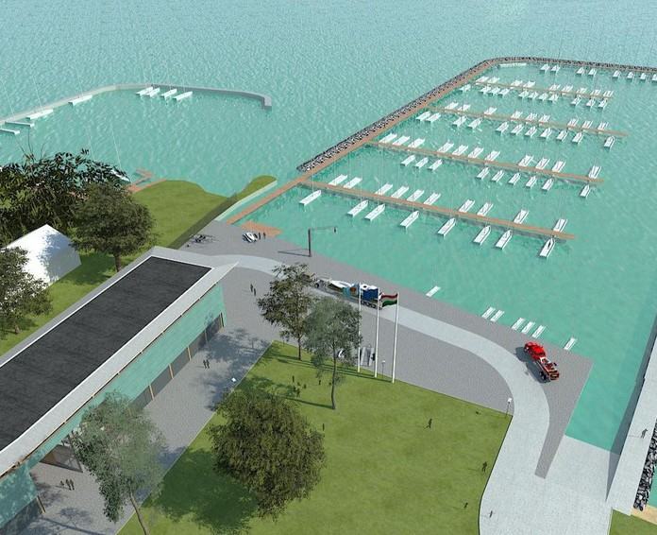
ABOUT
HUNGARIAN YACHTING ASSOCIATION
Mári Érdi (Laser Radial) Qualification for Tokyo
Zsombor Berecz (Finn Dinghy)
World Champion 2018 & Qualification for Tokyo
The Hungarian Yachting Association, founded in 1929, is an organization consisting of member societies. The sailors become part of the sport through their membership.
The HYA's main goal to win in medal in Tokio 2020
The Association has 143 member organizations, with nearly 4000 licensed racers participating in the competitions. The member societies organize more than 200 sailing races per year on the lakes of Hungary. The sailors can race in 50-55 different categories and fleets for the national champion prize.
HYA’s New International Sailing Center in Balatonfüred
Construction starts early 2019, opening in spring 2020
HUNGARIAN YACHTING ASSOCIATION | HUNSAIL. HU

Slide 10
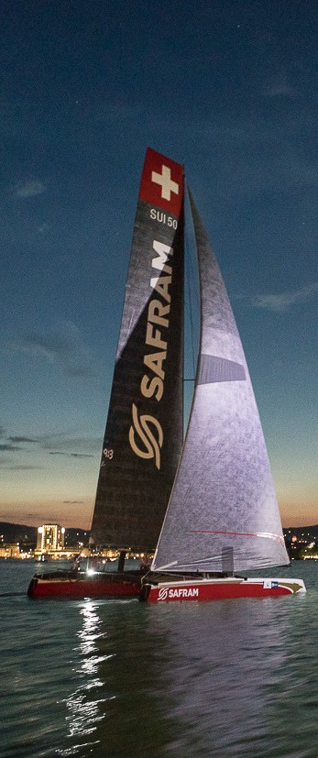
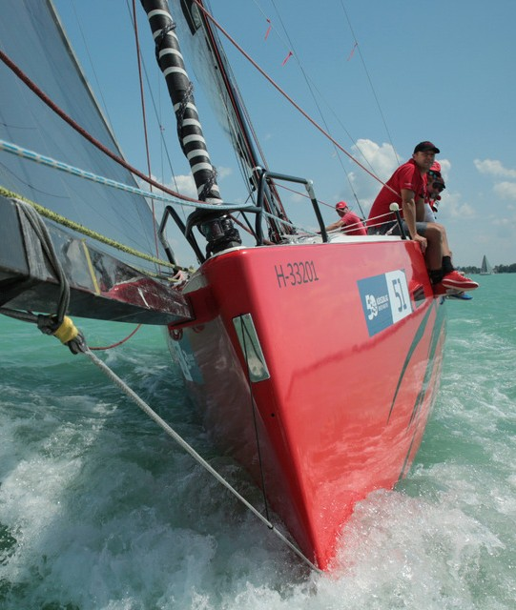
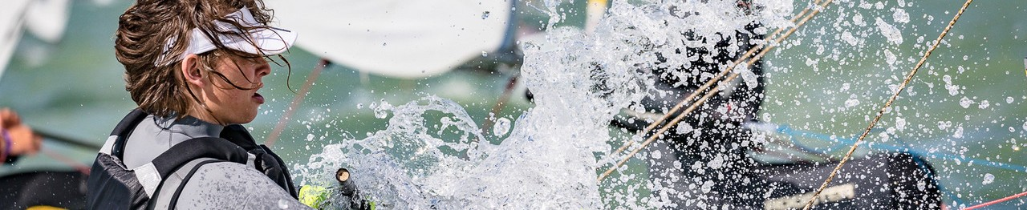

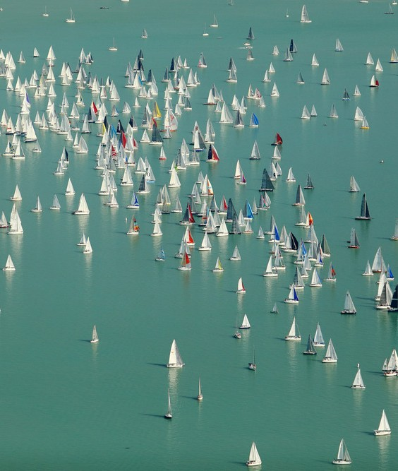


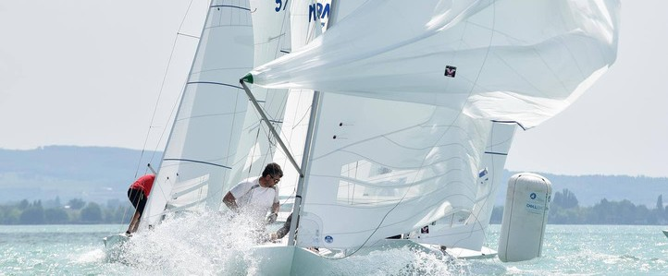
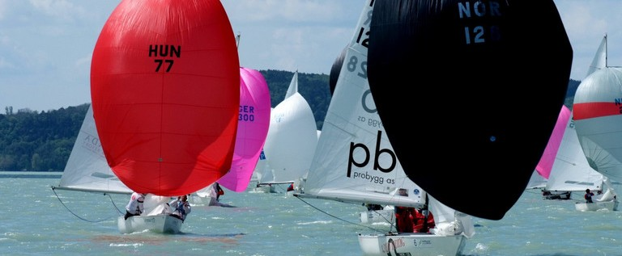
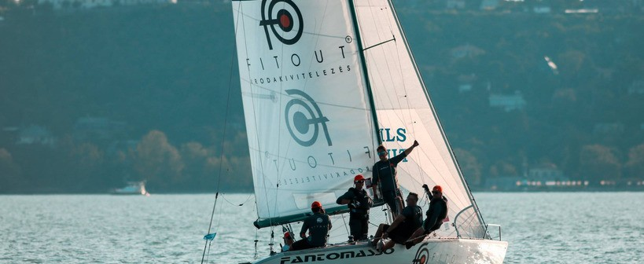


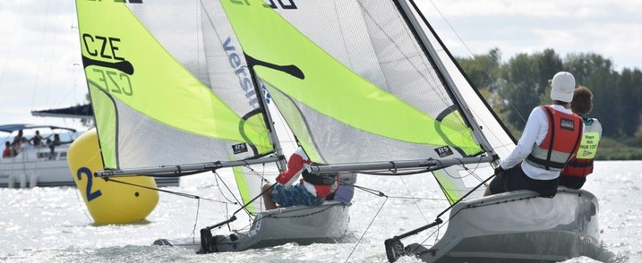
INTERNATIONAL EVENTS
The Kékszalag Regatta
4-8 international competitions per year
The oldest, longest international lake rounding regatta in Europe
681 boats
3300 sailiors
HUNGARIAN YACHTING ASSOCIATION | HUNSAIL. HU

Slide 11
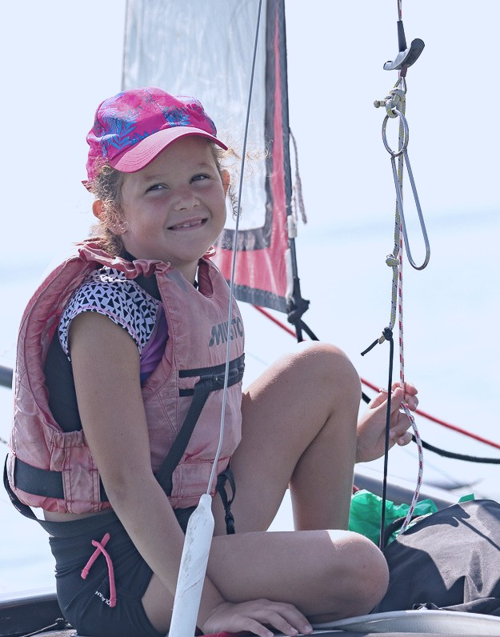
YOUTH SAILING
Total number of racers
600
551
Sailing Schools: 120% increase
Adolescent Youth
392
411
352
400
Youth Age Racers:
56% increase
Adolescent Racers:
18% increase
200
0
2015
2016
2017
2018
The numbers of young sailors has doubled in the past 5 years
HUNGARIAN YACHTING ASSOCIATION | HUNSAIL. HU

Slide 12
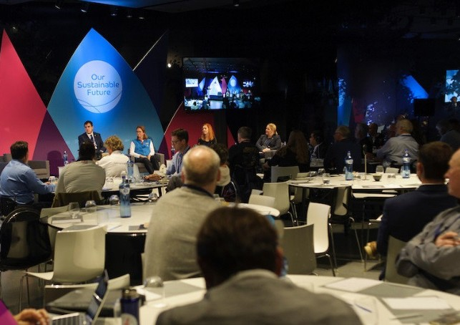
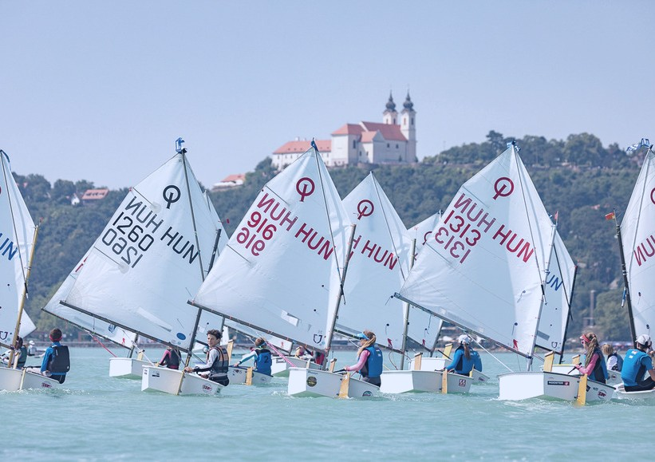
PROGRAMS
HYA cooperation with World Sailing
2013
World Sailing Training review
2013 –2016
Technical course for Coaches (level 1,2,3) – Balatonfüred host city
2015
Youth Worlds Emerging Nations Performace Clininc – Balatonfüred host city, with ws scholarship Maria Érdi became the Youth World Champion in Langkawi
2015
World Sailing Training Scholarship – Dávid Brencsán
2015
ASSF founding for Balatonfüred Sailing School program engaging elemetary school students
2018
DNSS completed: HYA is prepared for World Sailing Audit
HUNGARIAN YACHTING ASSOCIATION | HUNSAIL. HU

Slide 13
Mailing address
1146 Budapest, Istvánmezei út 1-3.
Email address
hunsail@hunsail.hu
THANK YOU!
Phone number
+36 1 460 6925

